Slide 1

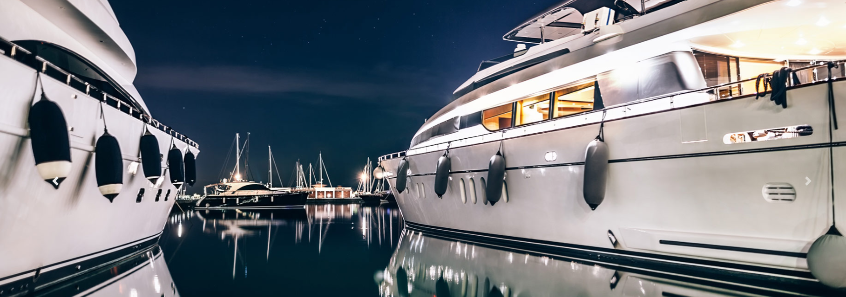
EMS
Electrical Marine Services
+30 6987795043
Kontokali, Marina Gouvia Kerkyra
ectricalservices@ems.com

Slide 2


EMS
Electrical Marine Services Yacht
For more than 15 years, our company, located in Corfu, has been active with electrical installations, in strong and weak currents, providing quality services and immediate service in Corfu and throughout Greece upon consultation.
Specializing in pleasure boats, the pleasure boat electrician and his team undertake electrical installations on new professional and pleasure boats as well as the reconstruction of any type of boat with certification to all Greek and international classification societies.
Our goals all these years are on the one hand the offer of quality and integrated services as well as the continuous support of each customer.

Slide 3
ABOUT US
Many years of experience in the marine field allows us to be well equipped when repairing on board as well as in our workshop, where we can rebuild and repair any machine related to the boat.
We have a wide variety of stock spare parts, while our suppliers have the largest range of electrical materials from all the houses in the domestic and international market.
Constantly monitoring all the new developments in the field as well as the new products on the market, our company can offer you modern, functional and quality services for any work related to the electrics of your professional boat or your pleasure boat.
Contact Us
& we will visit your vessel to discuss your needs and together find the ideal solutions. We serve Corfu, Greece, Albania & Croatia upon consultation.
+30 6987795043
Kontokali, Marina Gouvia Kerkyra
ectricalservices@ems.com

Slide 4
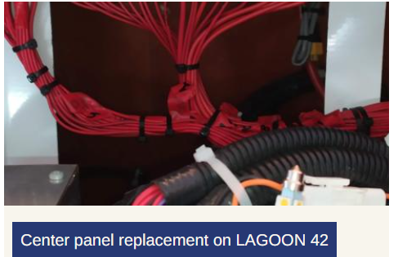
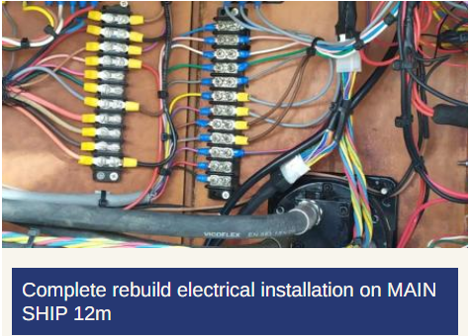
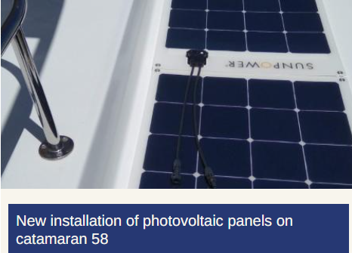
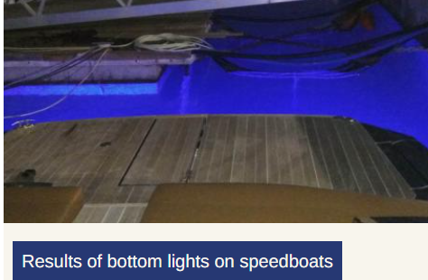
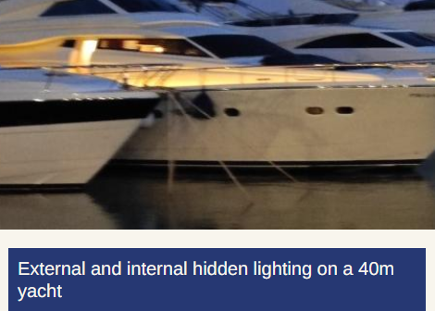
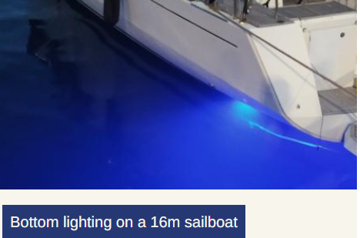
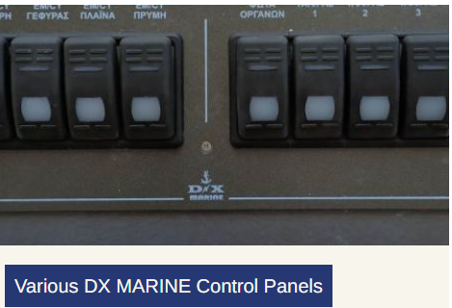
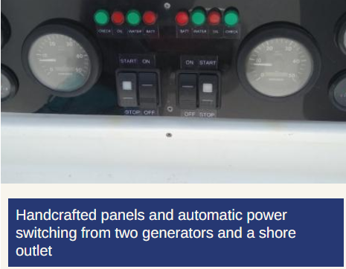
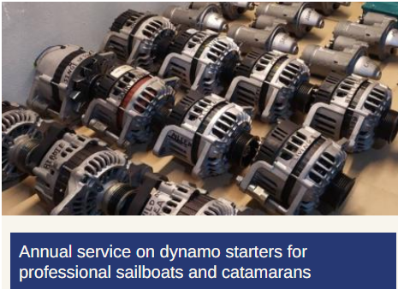
Our Works

Slide 5
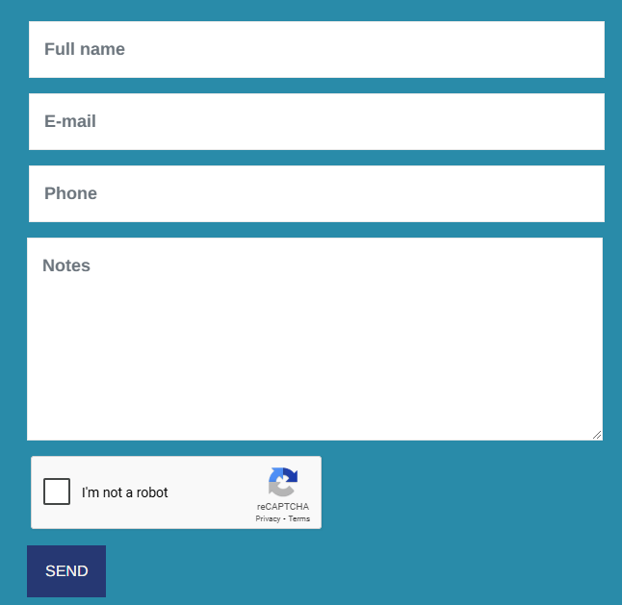

Contact Us
+30 6987795043
Kontokali, Marina Gouvia Kerkyra
ectricalservices@ems.com

